Slide 1

Housing Price Prediction
Submitted by:
Sudhanshu Kumar

Slide 2
Problem---
Problem Statement:
Houses are one of the necessary need of each and every person around the globe and therefore housing and real estate market is one of the markets which is one of the major contributors in the world’s economy. It is a very large market and there are various companies working in the domain. Data science comes as a very important tool to solve problems in the domain to help the companies increase their overall revenue, profits, improving their marketing strategies and focusing on changing trends in house sales and purchases. Predictive modelling, Market mix modelling, recommendation systems are some of the machine learning techniques used for achieving the business goals for housing companies. Our problem is related to one such housing company.
A US-based housing company named Surprise Housing has decided to enter the Australian market. The company uses data analytics to purchase houses at a price below their actual values and flip them at a higher price. For the same purpose, the company has collected a data set from the sale of houses in Australia. The data is provided in the CSV file below.
The company is looking at prospective properties to buy houses to enter the market. You are required to build a model using Machine Learning in order to predict the actual value of the prospective properties and decide whether to invest in them or not. For this company wants to know:
Which variables are important to predict the price of variable?
• How do these variables describe the price of the house?
Business Goal:
You are required to model the price of houses with the available independent variables. This model will then be used by the management to understand how exactly the prices vary with the variables. They can accordingly manipulate the strategy of the firm and concentrate on areas that will yield high returns. Further, the model will be a good way for the management to understand the pricing dynamics of a new market.
Technical Requirements:
• Data contains 1460 entries each having 81 variables.
• Data contains Null values. You need to treat them using the domain knowledge and your own understanding.
• Extensive EDA has to be performed to gain relationships of important variable and price.
• Data contains numerical as well as categorical variable. You need to handle them accordingly.
• You have to build Machine Learning models, apply regularization and determine the optimal values of Hyper Parameters.
• You need to find important features which affect the price positively or negatively.
• Two datasets are being provided to you (test.csv, train.csv). You will train on train.csv dataset and predict on test.csv file

Slide 3
Data Anaylsis ---
Quality of Basement Kitchen affects the price of the houses.
Maximum data contains MS subclass as 60.
The train data contains 1168 rows and 81 columns and test contains 292 rows and 80 columns (Sale Price missing).
The data contains continuous as well as descrete data.
The data containg categorical data.
Pool QC contains a lot of missing values hence could be removed.
There are a lot of outliers and skewness in the data.
There are a lot of null values in the data set that needs to be pre processed.

Slide 4
EDA Process---
Data Preprocessing Done.
OneHot Encoded all the data categorical data- We encode the categorical data in this step, to convert it to integer type, since the model does not work on ‘string’ data.
Regularised the data using standard Scaler.- The next step is to bring the data to a common scale, since there are certain columns with very small values and some columns with high values. This process is important as values on a similar scale allow the model to learn better. We use standard scaler for this process.
Removed the skewness using power transform-yeo-Johnson- The Yeo–Johnson transformation allows also for zero and negative values in the dataset.
Data Inputs- Logic- Output Relationships.
Since there were a lot of columns that had tremendous relationship with the Sale price used sklearn.decomposition.PCA to get the input for the desired output.

Slide 5
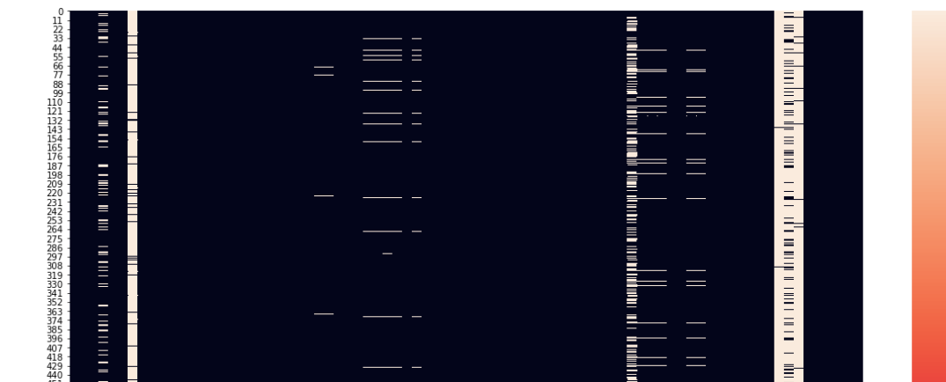
EDA and Visualization---
The given Data has a lot of null values that needed to be removed.

Slide 6
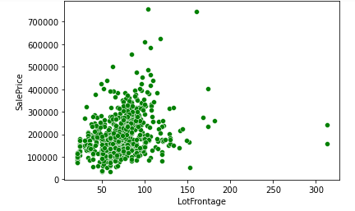
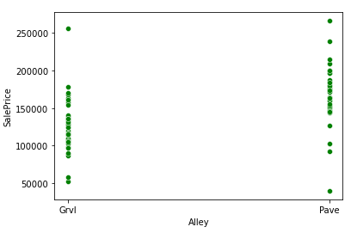
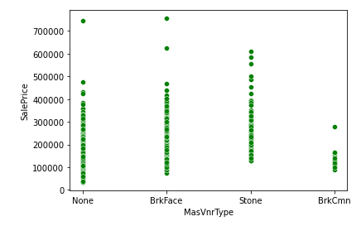
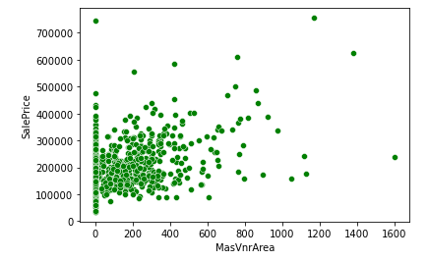
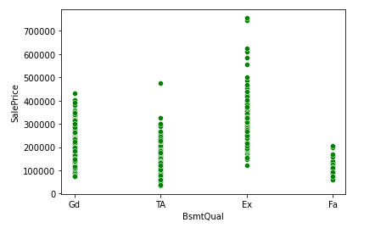
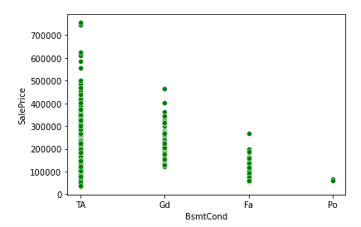

Slide 7
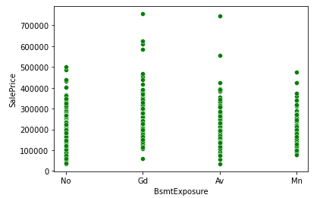
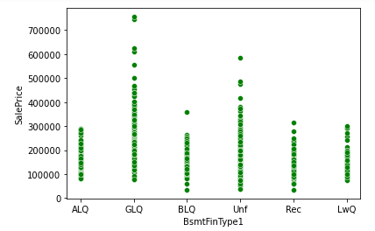
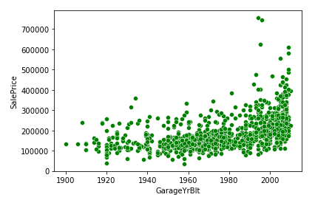
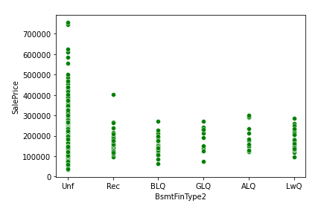
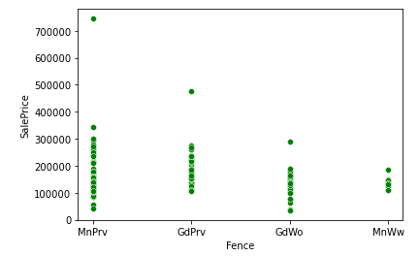
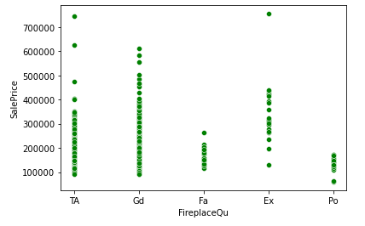

Slide 8
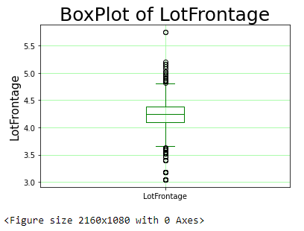
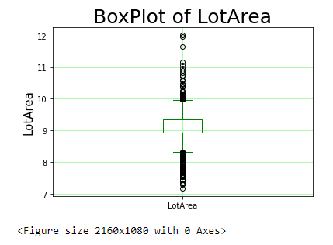
From the above chart we could make that most of the factors are affecting the sales price.
Outliers were also present in the given dataset.

Slide 9
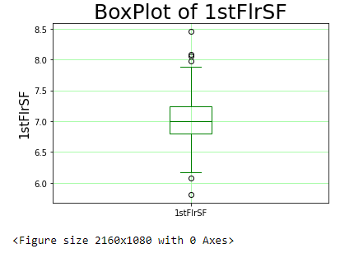
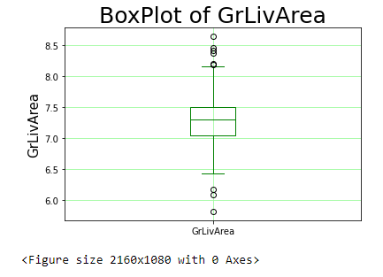
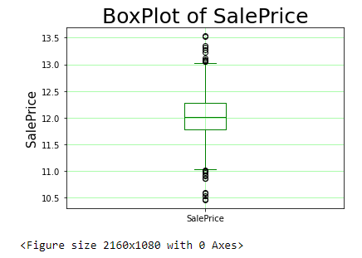

Slide 10
Data Preprocessing---
OneHot Encoded all the data categorical data- We encode the categorical data in this step, to convert it to integer type, since the model does not work on ‘string’ data.
Regularised the data using standard Scaler.- The next step is to bring the data to a common scale, since there are certain columns with very small values and some columns with high values. This process is important as values on a similar scale allow the model to learn better. We use standard scaler for this process.
Removed the skewness using power transform-yeo-Johnson- The Yeo–Johnson transformation allows also for zero and negative values in the dataset.

Slide 11
Since there were a lot of columns that had tremendous relationship with the Sale price used sklearn,decomposition and PCA to get the input for the desired output.

Slide 12
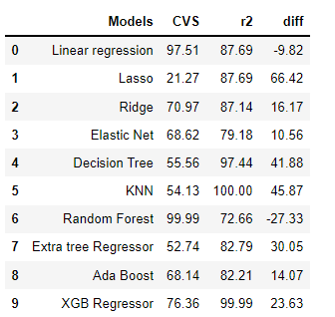
Model Development and Visualization
I tried Different models and i got different results.
From the above analysis Linear Regressor has least difference between r2 and cvs

Slide 13
Using hyper parameter tuning on LinearRegressor further increased the accuracy.
Linear regression is an attractive model because the representation is so simple.
The representation is a linear equation that combines a specific set of input values (x) the solution to which is the predicted output for that set of input values (y). As such, both the input values (x) and the output value are numeric.
The linear equation assigns one scale factor to each input value or column, called a coefficient and represented by the capital Greek letter Beta (B). One additional coefficient is also added, giving the line an additional degree of freedom (e.g. moving up and down on a two-dimensional plot) and is often called the intercept or the bias coefficient.

Slide 14
Model Evaluation using below
Hypertuning the model
GridSearch CV is a technique used to validate the model with different parameter combinations, by creating a grid of parameters and trying all the combinations to compare which combination gave the best results.
Cross Validation
We perform the cross validation of our model to check if the model has any overfitting issue, by checking the ability of the model to make predictions on new data, using k-folds. We test the cross validation for all models

Slide 15
Conclusion---
Key Findings and Conclusions of the Study.
The model that fits best is Linear Regression.
Learning Outcomes of the Study in respect of Data Science.
Since a lot of factors were related to the Sales Price it was very difficult to determine the best features hence PCA was used.
The data was highly spread and contained a lot of skewness which was removed by yeo-johnson which reduced the skewness in data.
Used Linear Regression as it works best with a little bit of outliers in the dataset.
Limitations of this work and Scope for Future Work
Since a lot of data was not recorded we filled it using the best strategy so there could be some deviation with the actual data.
The training dataset contained only 1168 records. The more the data the better the learning.
Current recorded data to be provided for better results in future.

